Slide 1


Orestis Bouras
10/11/2023

Slide 2

Outline
Executive Summary
Introduction
Methodology
Results
Conclusion
Appendix

Slide 3
Executive Summary
The target of this capstone assignment is to predict if the SpaceX Falcon 9 first stage will land successfully. The data which was used to complete the investigation are originated from the SpaceX launch dataset while the main steps followed are summarized below:
Data collection, wrangling and formatting
Exploratory data analysis
Interactive visual analytics
Predictive analysis with several classification algorithms
Based on the investigation, it was concluded that some of the rockets’ features have a strong correlation to the outcome of the launches and can guide the final result. Furthermore, after executing and comparing the accuracies of several classification algorithms, it is concluded that the decision tree algorithm performs the best on predicting if the Falcon 9 first stage will be landed successfully.

Slide 4
Introduction
In this capstone, we will predict if the Falcon 9 first stage will land successfully. SpaceX advertises Falcon 9 rocket launches on its website with a cost of 62 million dollars; other providers cost upward of 165 million dollars each, much of the savings is because SpaceX can reuse the first stage. Therefore, if we can determine if the first stage will land, we can determine the cost of a launch. This information can be used if an alternate company wants to bid against SpaceX for a rocket launch.
The main question to be answered from this capstone assignment is if the first stage of the rocket will land successfully. Towards getting a handle on the problem and providing a complete answer, a detailed investigation is performed; at first the available data are analyzed and interpreted and based on interactive visual analytics, a machine learning algorithm is developed to provide a prediction with a satisfying accuracy.

Slide 5

Section 1

Slide 6
Methodology
1. Data collection methodology using:
SpaceX API
Web scraping
2. Perform data wrangling, formatting and exploratory data analysis (EDA) using:
Pandas and NumPy libraries
SQL
3. Perform interactive visual analytics:
Matplotlib and Seaborn libraries
Folium
Dash
4. Perform predictive analysis using classification algorithms as:
Logistic Regression
Support vector machine (SVM)
Decision tree
K-nearest neighbors (KNN)

Slide 7
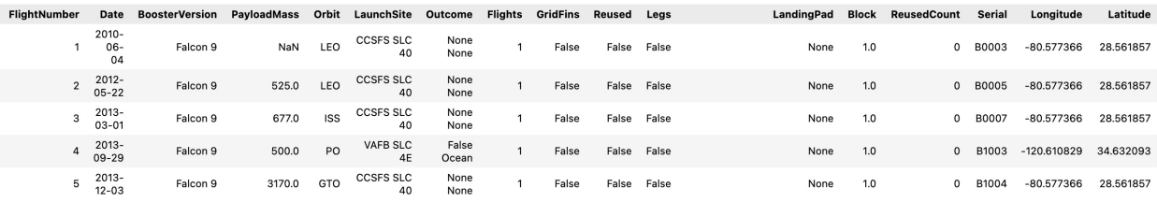
Data Collection – SpaceX API
The API data can be found in api.spacexdata.com/v4/rockets/
The API provides data about several types of rocket launches that are executed by SpaceX. The current assignemnt is focused on the Falcon 9 launches, thus the data are filtered on the ‘BoosterVersion’ column.
Several columns include missing values. For the ‘PayloadMass’ column, the missing values are replaced by the column’s mean value.
The head of the formated dataframe is presented below:
The complete jupyter notebook file where the Data Collection API process is developped can be found within my GitHub repository in IBM-Data-Science-Capstone-Project/1_Data Collection API.ipynb at main · Bouraso/IBM-Data-Science-Capstone-Project (github.com)

Slide 8
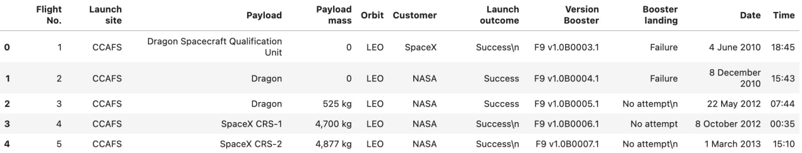
Data Collection – Web Scraping
The data is scraped from List of Falcon 9 and Falcon Heavy launches - Wikipedia
The main dataframe is created through a BeautifulSoup object and by parsing the launch HTML tables
The following picture presents the head of the final dataframe:
The complete jupyter notebook file where the Data Collection with Web Scraping process is developped can be found within my GitHub repository in IBM-Data-Science-Capstone-Project/2_Data Collection with Web Scraping.ipynb at main · Bouraso/IBM-Data-Science-Capstone-Project (github.com)

Slide 9
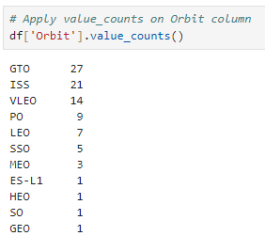
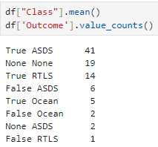
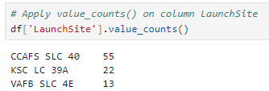
Data Wrangling
Functions from the Pandas & NumPy libraries were used to derive useful information about the data (pictures below). For example:
Calculate the number of launches per LaunchSite via the “value_counts()” function
Similarly, calculate the number of launches per Orbit
An extra column “Class” was added, being equal to 0 if the Outcome was a failure or to1 if it was a success
Calculation of Success rate based on the mean value of “Class” and the “Outcome” column
The complete jupyter notebook file where the Data Wrangling process is developped can be found within my GitHub repository in IBM-Data-Science-Capstone-Project/3_Data Wrangling.ipynb at main · Bouraso/IBM-Data-Science-Capstone-Project (github.com)

Slide 10
EDA with SQL
In this step, several SQL queries were used to answer important questions about the data. A summarized list of the main SQL queries and the relevant information is presented below:
Remove the blanks from the table
Display the names of each unique launch site
Display 5 records where launch sites begin with the string ‘CCA’
Display the total payload mass carried by boosters launched by NASA (CRS)
Display the average payload mass carried by booster F9 v1.1
List the date when the first successful landing outcome in ground pad was achieved
List the boosters with success in drone ship and with payload mass between 4000 and 6000
List the total number of successful and failure mission outcomes
List the booster versions which have the maximum payload mass
List the records (specified columns) in year 2015
Rank the count of landing outcomes between a specified date period
The complete jupyter notebook file where the EDA with SQL process is developped can be found within my GitHub repository in IBM-Data-Science-Capstone-Project/4_EDA with SQL.ipynb at main · Bouraso/IBM-Data-Science-Capstone-Project (github.com)

Slide 11
EDA with Data Visualization
In this step, functions from Matplotlib and Seaborn libraries were used to visualize the data through different kinds of plots (scatterplot, bar-plot, line chart) and gain insights on the relationships between the features of the data.
The plots are summarized below:
Relationship between Flight Number and Payload Mass with a scatterplot
Relationship between Flight Number and Launch Site with a scatterplot
Relationship between Payload Mass and Launch Site with a scatterplot
Success Rate per Orbit Type with a bar-plot
Relationship between Flight Number and Orbit Type site with a scatterplot
Relationship between Payload Mass and Orbit Type site with a scatterplot
Average Success Rate per Year with a line chart
The complete jupyter notebook file where the EDA with Data Visualization process is developped can be found within my GitHub repository in IBM-Data-Science-Capstone-Project/5_EDA with Visualization.ipynb at main · Bouraso/IBM-Data-Science-Capstone-Project (github.com)

Slide 12
Build an Interactive Map with Folium
In this step, functions from the Folium library were used to visualize the data through interactive maps.
The Folium library is used to:
Mark all launch sites on a map
Mark the succeeded and failed launches for each site on the map
Mark the distances between a launch site to its proximites such as the nearest city, railway or highway
The complete jupyter notebook file where the Interactive Maps with Folium are developped can be found within my GitHub repository in IBM-Data-Science-Capstone-Project/6_Interactive Visual Analytics with Folium.ipynb at main · Bouraso/IBM-Data-Science-Capstone-Project (github.com)

Slide 13
Build a Dashboard with Plotly Dash
In this step, functions from the Dash library were used to generate an interactive dashboard where the user can easily and quickly scroll on a ‘Launch Site’ dropdown menu and a ‘Payload Mass’ range slider to further filter and investigate the data.
Using a pie chart and a scatterplot, the interactive dashboard shows:
The total success launches for each launch site
The total success launches for the launch site with the highest success rate
The correlation between the payload mass and the mission outcome (success or failure) for each launch site with different payload selected in the range slider
The complete python script where the Dashboard with Plotly Dash is developped can be found within my GitHub repository in IBM-Data-Science-Capstone-Project/7_Build an Interactive Dashboard with Ploty Dash.py at main · Bouraso/IBM-Data-Science-Capstone-Project (github.com)

Slide 14
Predictive Analysis (Classification)
In this step, functions from the Scikit-learn library are used to create and compare the accuracies of several machine learning models.
The machine learning prediction analysis includes the following steps:
Standarizing the data
Splitting the data into train & test data
Creating the machine learning models with the following algorithms:
Logistic Regression
Support Vector Machine (SVM)
Decision tree
K-nearest neighbors (KNN)
Fit the models on the training set
Find the best combination of hyperparameters for each model
Evaluate the models based on their accuracy scores and confusion matrix
The complete jupyter notebook file where the Predictive Analysis is developped can be found within my GitHub repository in IBM-Data-Science-Capstone-Project/8_Machine Learning Prediction.ipynb at main · Bouraso/IBM-Data-Science-Capstone-Project (github.com)

Slide 15

Section 2

Slide 16
Results
The results are split on the upcoming slides into the following Sections:
Section2:
SQL (EDA with SQL)
Visualization: Matplotlib and Seaborn
Section3:
Folium
Section4:
Dash
Section5:
Predictive Analysis

Slide 17
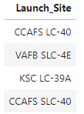
Results SQL: All Launch Site Names
The names of the unique launch sites in the space mission:
The query uses the ‘DISTINCT’ function to identify the unique sites:

Slide 18
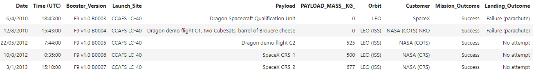
Results SQL: Launch Site Names Begin with 'CCA'
The 5 records where launch sites begin with ‘CCA’ are:
The query uses the ‘LIKE’ function to specify which characters should the name contain and ‘LIMIT’ to show only the first 5 records:

Slide 19
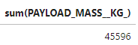
Results SQL: Total Payload Mass
The total payload mass carried by the boosters launched by NASA (CRS) is:
The query uses the ‘SUM’ aggregation function to summarize the payload mass and the ‘WHERE’ to specify the wanted customer:

Slide 20
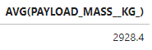
Results SQL: Average Payload Mass by F9 v1.1
The average payload mass carried by the booster version F9 v1.1 is:
The query uses the ‘AVG’ aggregation function to calculate the average of the payload mass and the ‘WHERE’ to specify the wanted booster version:

Slide 21
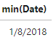
Results SQL: First Successful Ground Landing Date
The first successful ground landing date is:
The query uses the ‘MIN’ aggregation function to return the first date and the ‘WHERE’ to specify the wanted landing outcome:

Slide 22
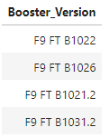
Results SQL: Successful Drone Ship Landing with Payload between 4000 and 6000
The names of the boosters that have a successful drone ship landing and a payload mass between 4000 and 6000kg are:
The query uses the ‘DISTINCT’ function to identify the unique boosters, the ‘WHERE’ to specify the wanted landing outcome and the ‘AND / BETWEEN’ to limit the payload mass:

Slide 23
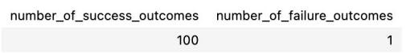
Results SQL: Total Number of Successful and Failure Mission Outcomes
The total number of successful and failure missions outcomes is:
The query uses the ‘COUNT’ aggregation function to count the rows and the ‘GROUP BY’ function to group the data based on the specified feature:

Slide 24
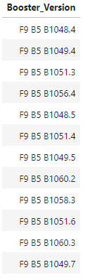
Results SQL: Boosters Carried Maximum Payload
The names of the boosters that carried the maximum payload mass are:
The query uses the ‘MAX’ aggregation function to find the maximum payload mass within a subquery:

Slide 25
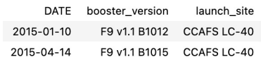
Results SQL: 2015 Launch Records
The failed landing outcomes in drone ship, their booster version and the launch site are:
The query uses the ‘FORMAT’ function to change the date format to month and year-specific and the ‘WHERE’ function for further filtering:

Slide 26
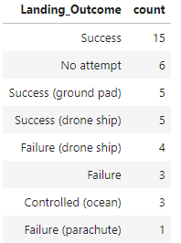
Results SQL: Rank Landing Outcomes Between 2010-06-04 and 2017-03-20
The ranking of the landing outcomes for the specified date period is:
The query uses is counting the existent rows per landing outcome after filtering on the specified dates:

Slide 27
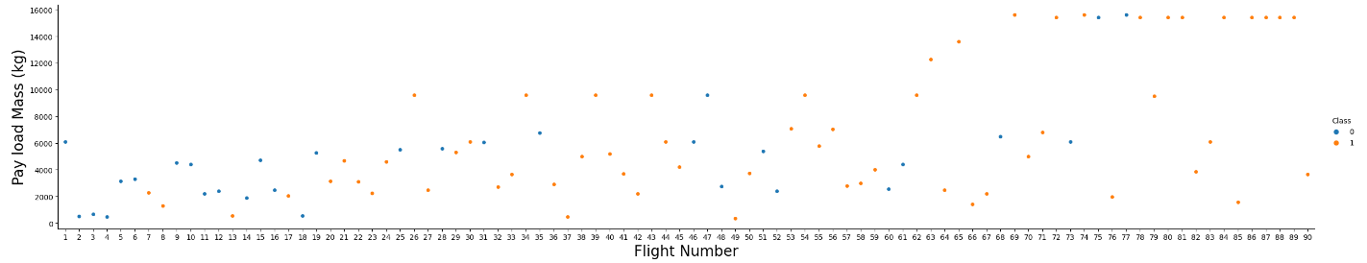
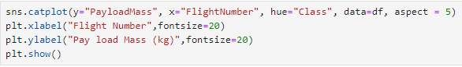
Visualization: Flight Number vs. Payload
The relationship between the Flight Number and the Payload Mass is displayed below:
Insights:
As the Flight Number increases, it is more likely to have a successful landing

Slide 28
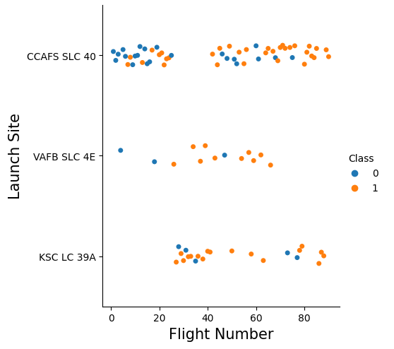
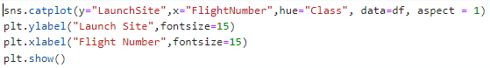
Visualization: Flight Number vs. Launch Site
The relationship between the Flight Number and the Launch Site is displayed below:
Insights:
Each Launch Site has a different Success Rate

Slide 29
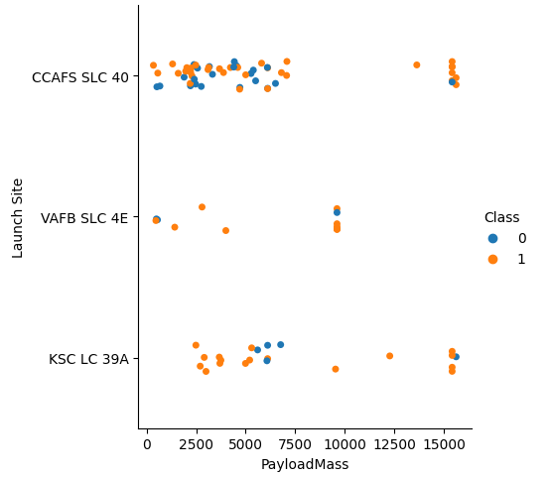
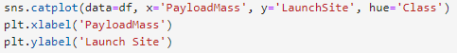
Visualization: Payload vs. Launch Site
The relationship between the Payload Mass and the Launch Site is displayed below:
Insights:
The VAFB SLC site has no launches for heavy payload mass (>10000kg)

Slide 30
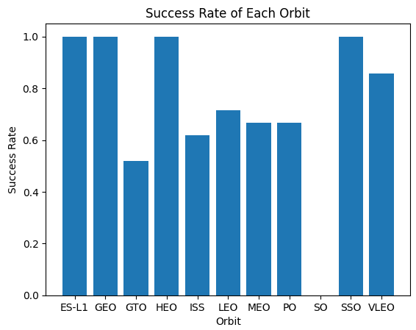
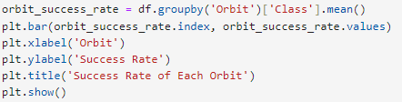
Visualization: Success Rate vs. Orbit Type
The Success Rate per Orbit Type is displayed below:
Insights:
The Orbit GTO has the lowest success rate
Several Orbits have 100% success rate (ES-L1, GEO, HEO, SS)

Slide 31
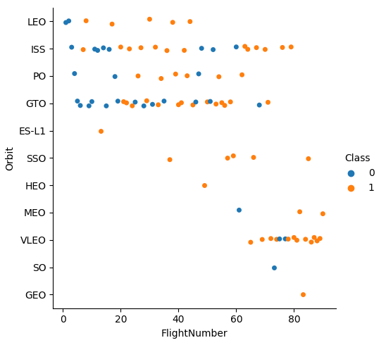
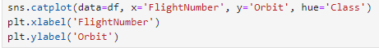
Visualization: Flight Number vs. Orbit Type
The relationship between the Flight Number and the Orbit Type is displayed below:
Insights:
The LEO Orbit has a success rate related to the number of flights
For the GTO Orbit, no relationship was detected

Slide 32
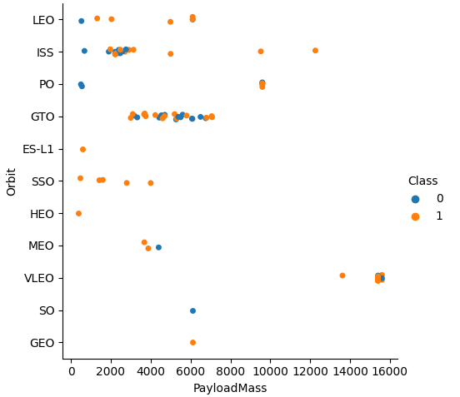
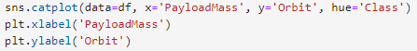
Visualization: Payload vs. Orbit Type
The relationship between the Orbit Type and the Payload Mass is displayed below:
Insights:
With heavy payloads ISS and PO present a high success rate
No relationship detected for the GTO

Slide 33
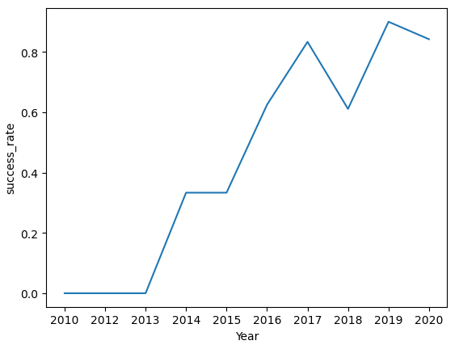
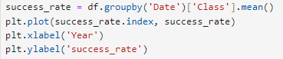
Visualization: Launch Success Yearly Trend
The Success Rate per Year is displayed below:
Insights:
The success rate since 2013 kept increasing with a small dr in 2018

Slide 34

Section 3

Slide 35
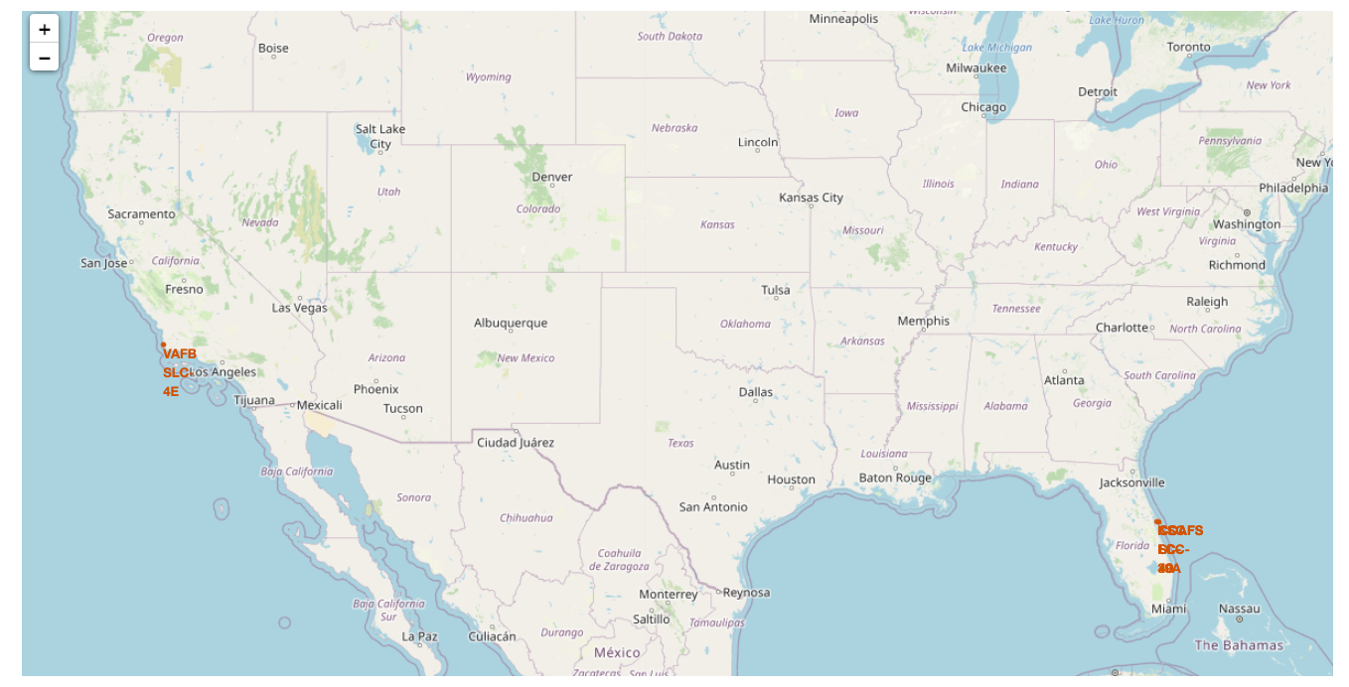
Folium: Launch Sites on Map
All the Launch Sites are depicted with a Circle and a Marker on the map below:
Insights:
All launch sites seem to be in close proximity to the coast

Slide 36
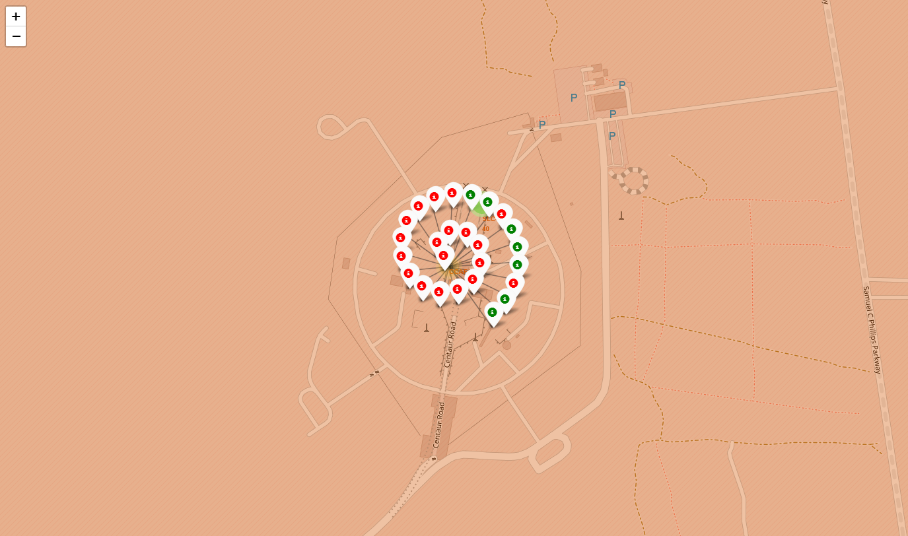
Folium: Succeeded & Failed Launches on Site
The succeeded and failed Launches for each site on Map → zooming in one of the launch sites, the green (successful launch) and the red (failed launch) tags can be viewed:
Insights:
By zooming on each launch site, the success rate of each site can be easily estimated from the colored tags

Slide 37
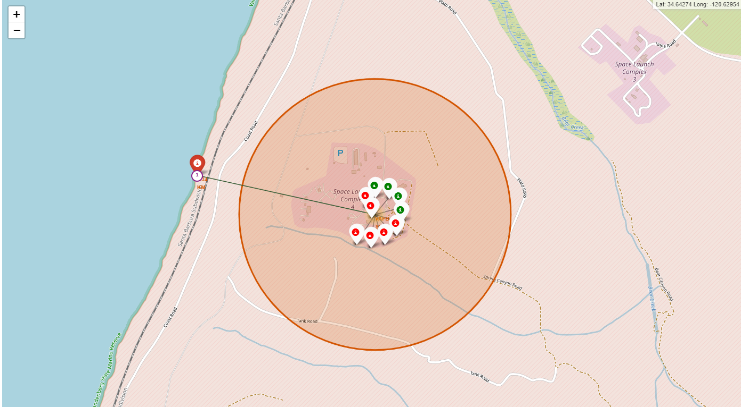
Folium: Distance between Site and its proximities
The distances between a Launch Site to its proximities such as the nearest city, railway or highway → the picture below shoes the distance between the VAFB SLC-4E launch site and the nearest coastline (1.34km) :

Slide 38

Section 4

Slide 39
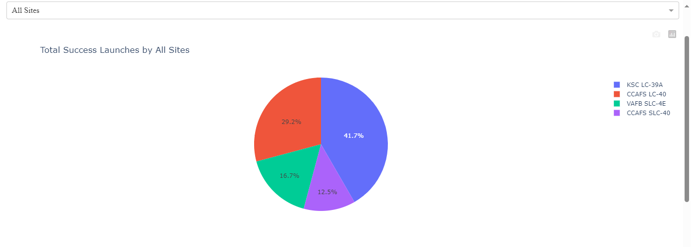
Dash: Total Success Launches by All Sites
The picture below represents the upper part of the dashboard where a pie chart displays the total success launches as a percentage for each Launch Site
The user has the possibility to select a single Launch Site with the dropdown arrow:

Slide 40
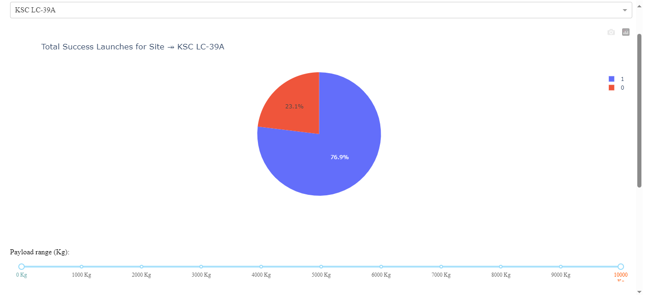
Dash: Launch Site with the highest Success Rate
The picture below represents the total Success Launches for the Site KSC LC-39A which is the site with the highest Success Rate based on the pie chart of the previous slide:

Slide 41
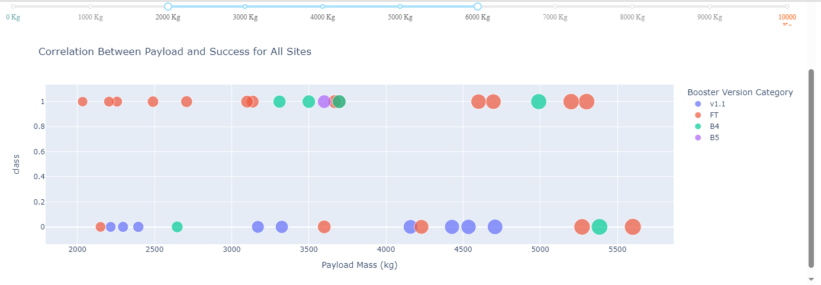
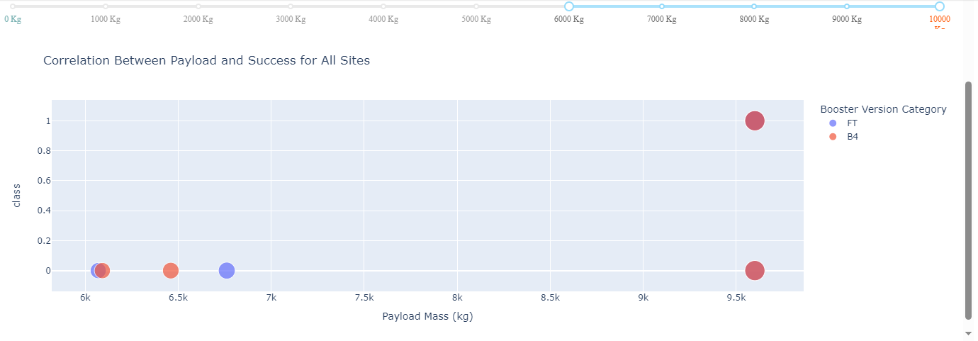
Dash: Payload vs. Launch Outcome for All Sites
The two pictures below show the Payload Mass vs. Outcome scatterplot for all the Sites for two different Payload Mass ranges:
The FT booster seems to have the highest success rate while the v1.1 has the lowest one
Significantly lower number of launches with a heavier payload
Significantly higher percentage of failed launches for the range of 6000-10000kg
2000 to 6000kg
6000 to 10000kg

Slide 42

Section 5

Slide 43
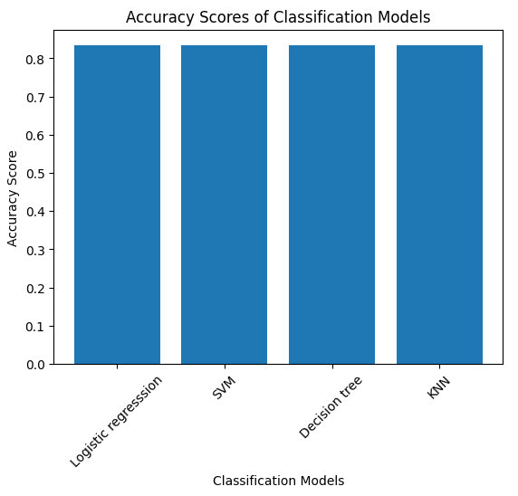
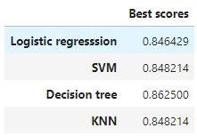
Classification Accuracy
On the left bar-plot, the Accuracy for each one of the 4 machines learning algorithms is displayed.
The Accuracy was calculated based on the method “score” on the test dataset.
The Accuracy is equal for all the 4 algorithms.
Therefore, the GridSearchCV best scored are compared to find the best performing algorithm. (table at the bottom)
The Decision Tree algorithm has the highest best score

Slide 44
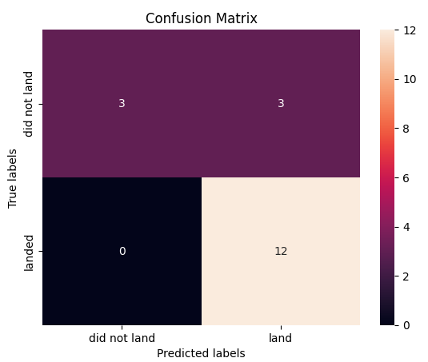
Confusion Matrix
On the left visual, the Confusion Matrix for the decision tree model is displayed.
Examining the Confusion Matrix, it seems that the specific model can fairly distinguish the different classes
The major problem on the prediction comes from the false positives (top-right square=3), meaning that the model predicts a successful landing while the true outcome was a failure

Slide 45
Conclusions
The main goal of this capstone assignment was to predict if the first stage of a given Falcon 9 launch will land successfully.
A dedicated dataset was thoroughly processed and analyzed through data collection, wrangling, formatting and visualization in order to identify possible patterns and correlations between the data’s features
Several features like Payload Mass and Orbit Type can strongly affect the launching outcome in a certain way and depending the Launch Site.
Important to note that the Total Success rate is increasing from 2013 onwards.
Four classification machine learning algorithms were employed and trained to be able to predict the Outcome based on the historical Flight data.
The predictive model produced by the Decision Tree algorithm performed the best. The major problem on that model comes from the false positive predictions

Slide 46
Appendix

Slide 47


